Slide 1
中国的婚姻习俗
Wedding Traditions in China

Slide 2

Four great happiness in ancient times
久旱逢甘霖
他乡遇故知
refreshing rain after a long drought
meeting an old friend in a distant land
refreshing rain after a long drought
refreshing rain after a long drought
refreshing rain after a long drought
1
2
4
3
洞房花烛夜
金榜题名时
Name titled on golden board
The wedding night

Slide 3
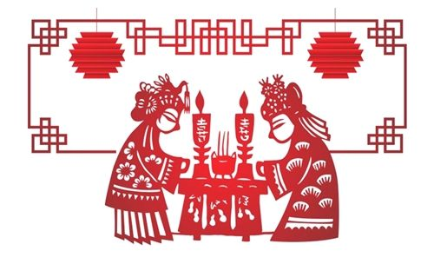
洞房花烛夜：The wedding night

Slide 4
目录（list)
一、婚礼的由来(Origin of wedding)
二、传统婚礼(Traditional wedding)
三、现代婚礼(Modern wedding)

Slide 5
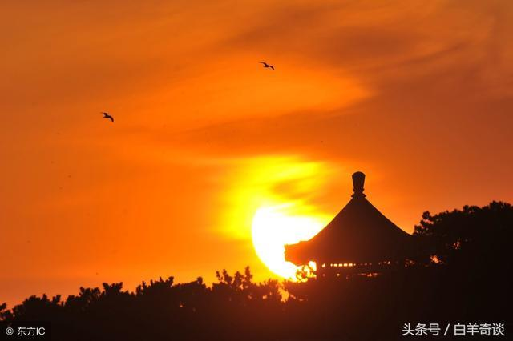
婚礼——昏礼
“婚礼”原来是“昏礼”(hūn lǐ )。
古人认为，黄昏时分是昼夜交替的时刻，阴阳调和，相生相长，此时结婚正是调和阴阳之气的好时候。如果新人结合能借助天时地利，必然大吉大利。
The ancients believed that twilight time was the time when day and night alternated, when Yin and Yang were in harmony and grew from each other.If the new combination can take advantage of the right place at the right time, the inevitable.

Slide 6
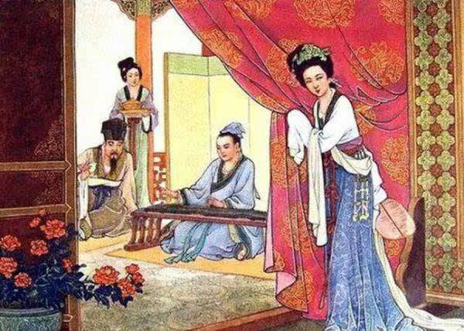
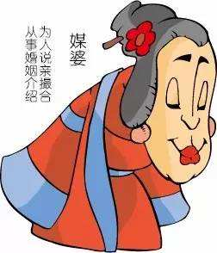
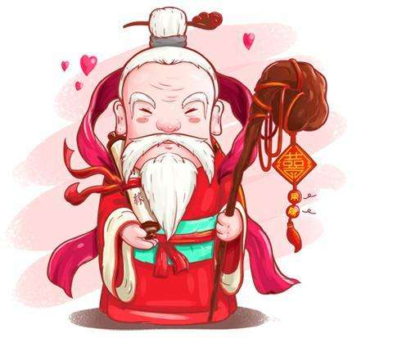
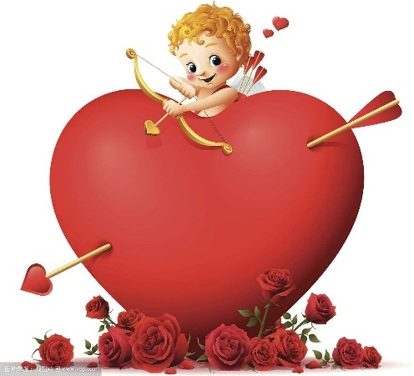
It is all about fate ，you could not choose by yourself.
parents
matchmaker
The old man under the moon
Cupid

Slide 7
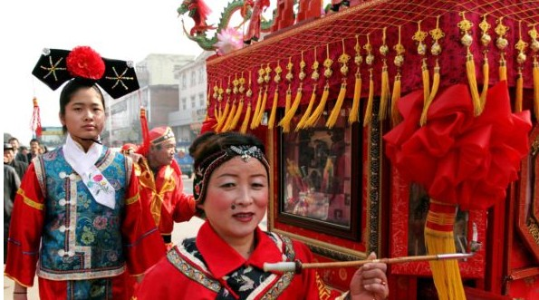
父母之命，媒妁之言
（Parent's and matchmaker's arragge）
老师，老师
In feudal （封建的）China, if an unmarried boy's parents find a girl they interested in, they will find an matchmaker to make the proposal.

Slide 8
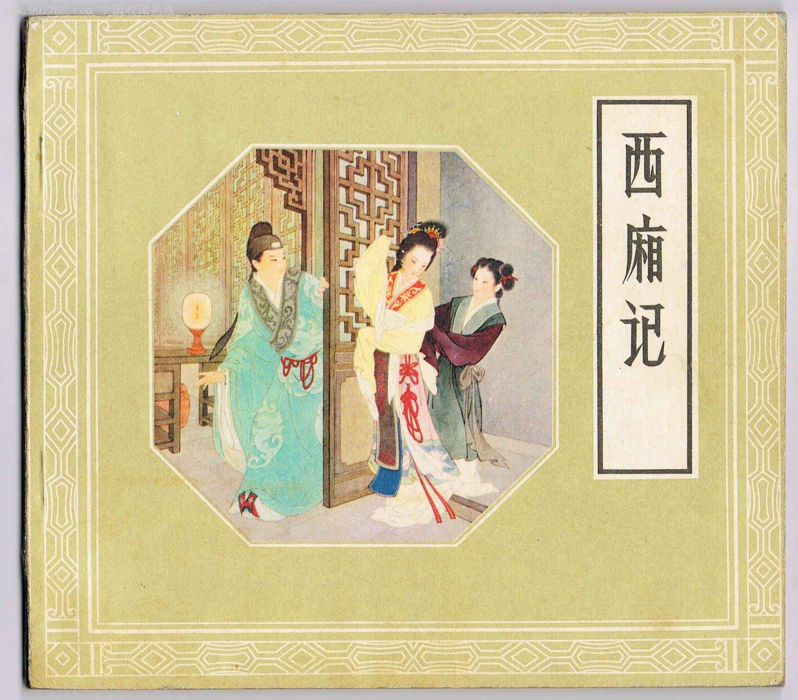
The words of parents are arranged
《西厢记》
它是中国具有700多年历史的杰作。
“愿有情人终成眷属。”
《Romance of the western bower》,
it is an masterpiece with more than seven hundred years of history in China.
“May all lovers unite in marriage.”
王实甫

Slide 9
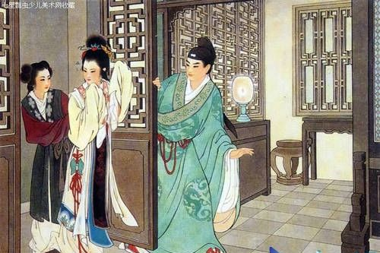
The words of parents are arranged
There is a matchmaker.

Slide 10
月老（matchmaker:the god who unites persons in marriage）
月老最早出现在唐朝小说集中，是中国民间传说中主管婚姻的红喜神。月下老人用红绳相系男女，确定男女姻缘。体现了唐朝人对爱情与婚姻“前世注定今生缘”的认知态度。对于从前那种结婚一定要讲求门当户对的观念来说，月老的婚姻观念显然有了很大的进步。
Yuelao first appeared in the tang dynasty novel collection, he is the Chinese folklore in charge of the marriage of the red god.It reflects the tang dynasty people's attitude towards love and marriage, "predestined to be born in the past".For the former kind of marriage must be stressed on the concept of the same family, the concept of marriage has obviously made great progress.
老师，老师

Slide 11
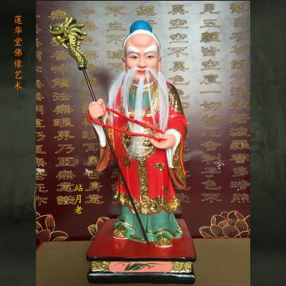
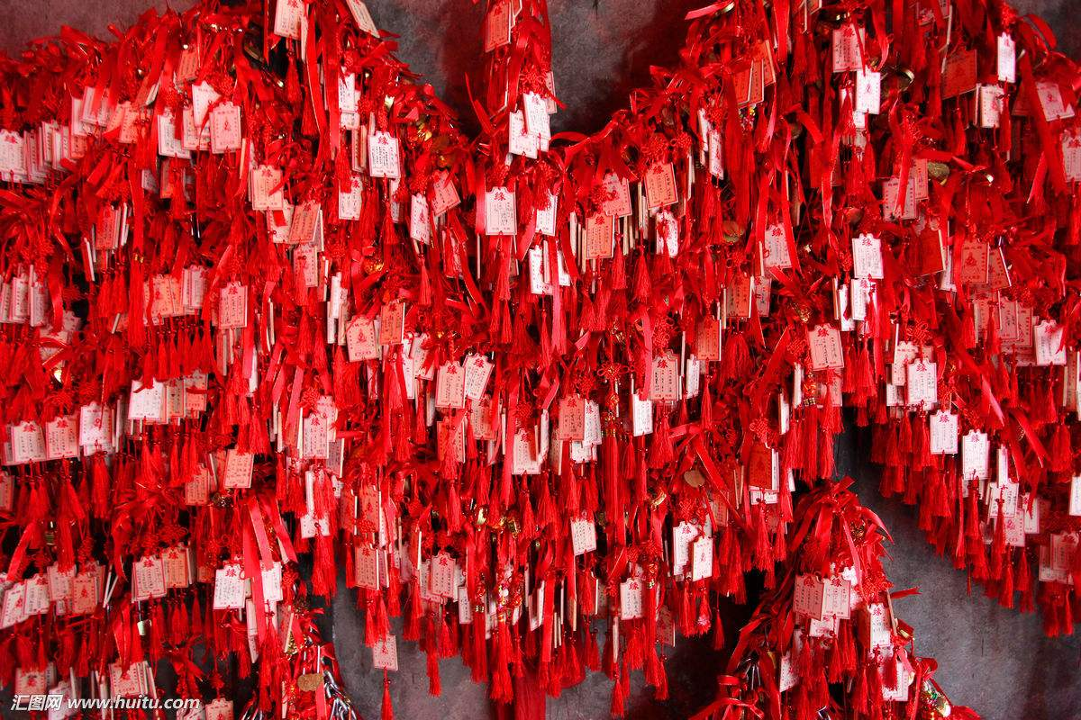
月老（matchmaker:the god who unites persons in marriage）
千里姻缘一线牵（Thousands of miles by marriage）
老师，老师
The matchmaker uses the red rope to tie men and women, to determine the marriage of men and women.It is all about fate.

Slide 12
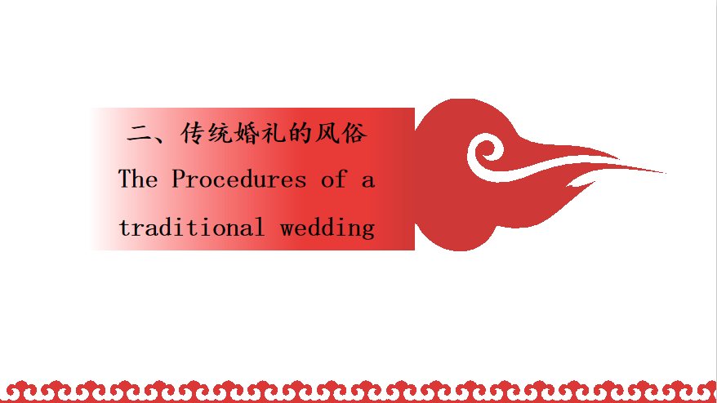

Slide 13
The Procedures of a
traditional wedding
1、婚前（Premarriage)
Three Letters And
Six Etiquettes
2、婚礼（wedding）
The customs
3、婚后（After marraige）
The customs

Slide 14
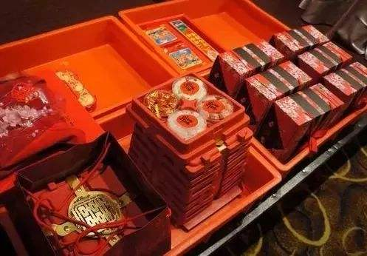
Three Letters And Six Etiquettes
三书六礼是中国的传统婚姻习俗礼仪。“三书”指在“六礼”过程中所用的文书，“六礼”是指由求婚至完婚的整个结婚过程。
In ancient times. it was very important to follow a basic principle of Three Letters And Six Etiquettes ."Three letters" refers to the documents used in the process of "six rites", "six rites"refers to the whole marriage process from proposal to marriage.
老师，老师

Slide 15
三书：Three Letters
Betrothal Letter
pìn shū
聘 书
sān shū
三 书
Three letters
Gift Letter
lǐ shū
礼 书
老师，老师
Wedding Letter
yínɡ shū
迎 书
"Three letters" is a document, is a guarantee of ancient marriage, exactly equivalent to the current marriage certificate.

Slide 16
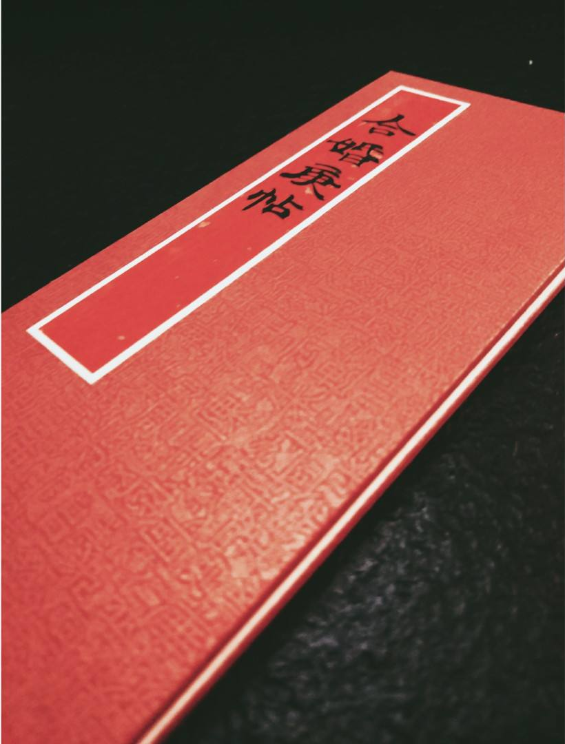
聘书 Betrothal Letter
聘书：是定亲的文书，在古代男女立定婚约的时候，男方家就交给女方家聘书。
Betrothal letters are engagement letters. In ancient times, when a man and a woman made an engagement, the man's family would give the betrothal letters to the woman's family.
老师，老师

Slide 17
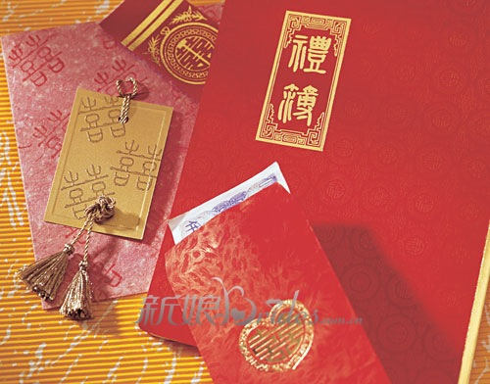
礼书 Gift Letter
礼书：是在过大礼时候需要用到的文书，主要列明过大礼的物品以及数量。
Gift Letter which would be given to the identified girl's family.Within the letter will be a list of the types and quantity of gifts designated for the wedding.
老师，老师

Slide 18
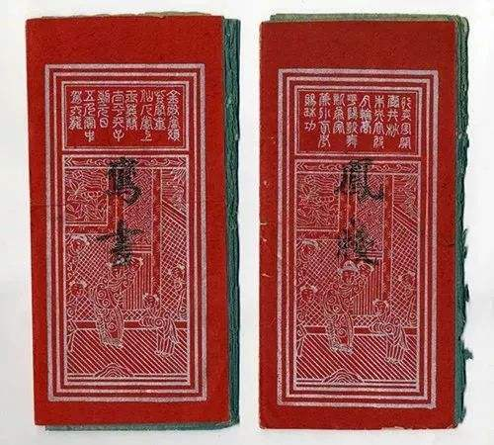
迎书 Wedding Letter
迎书：是迎娶新娘的文书，在迎娶新娘过门时，男方送给女方的文书。
Once both parties accept the marriage，the Wedding Letter is prepared and presented to the bride's family on the day of the wedding and is a document that confirmed and commemorated the formal acceptance of the bride into the bridegroom's family, with some adaptations of course.
老师，老师

Slide 19
six etiquettes
纳征
（Presenting wedding gifts）
纳采
（Proposal）
老师，老师
纳吉
请期
（Picking a wedding date）
问名
（Presenting betrothal gifts ）
（birthdate matching）
亲迎
（Wedding ceremony）

Slide 20
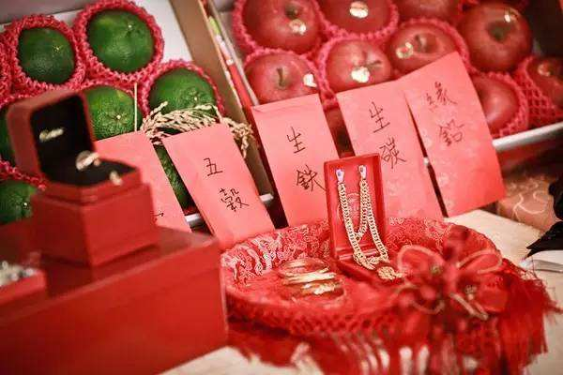
1.纳采Proposal
For boy side: If an unmarried boy's parents identify a girl as their future daughter-in-law, they will then locate a matchmaker. The matchmaker will formally present his client's request to the identified girl's parents，she will bring up proposal of marriage.
For girl side： Accept some gift to show agareement to marridge.
老师，老师

Slide 21
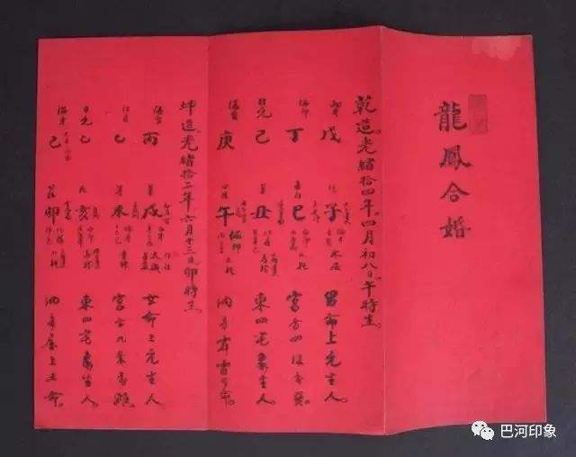
2.问名 Birthday matching
If the potential bride's parents do not object the marriage, the matchmaker will ask for the girl's name、age and traditional birth data/horoscope the ceremony to exchange ,that to assure the compatibility of the potential bride and groom. If the couple's birthdays and birth-hours do not conflict according to astrology, the marriage will step into the next stage. If there is any conflict,meaning the marriage will bring disasters upon both families , the proposed marriage is immediately quashed.

Slide 22
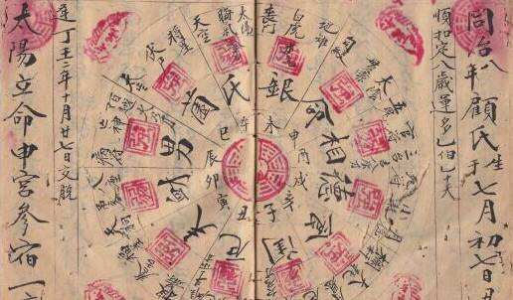
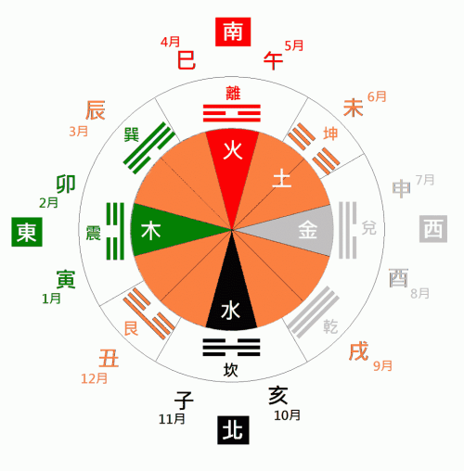
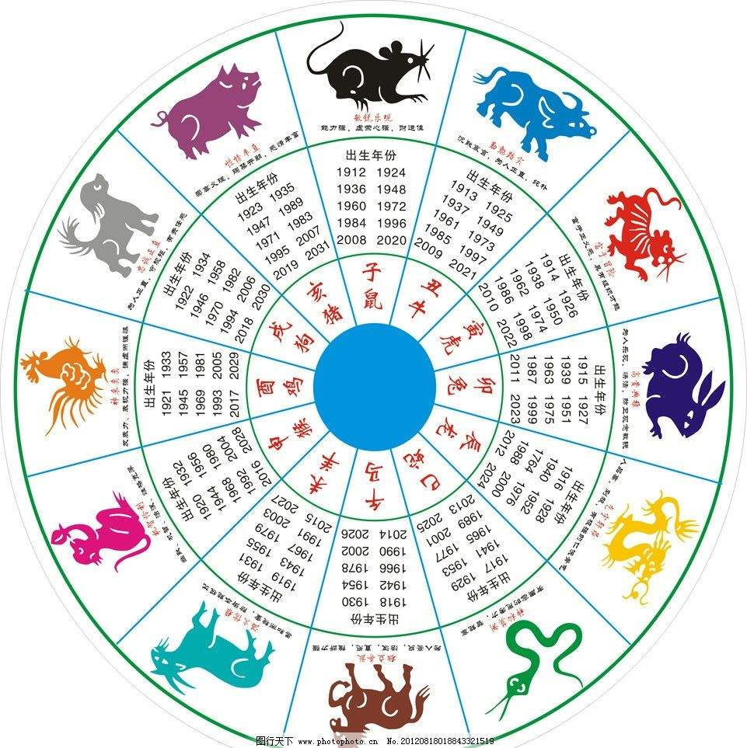
2.问名 Birthday matching
时辰hour
生肖Chinese zodiac

Slide 23
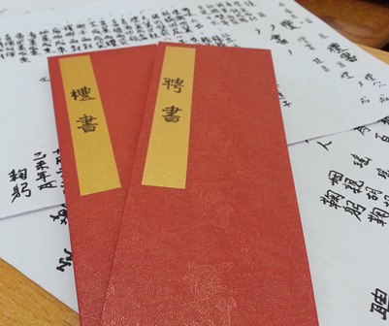
3.纳吉Presenting betrothal gifts
Once birthdays match, the groom's family will then arrange the matchmaker to inform girl family can get married，the matchmaker will present betrothal letter to the bride's family.

Slide 24
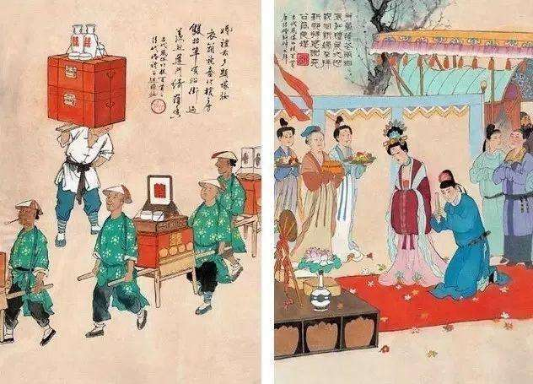
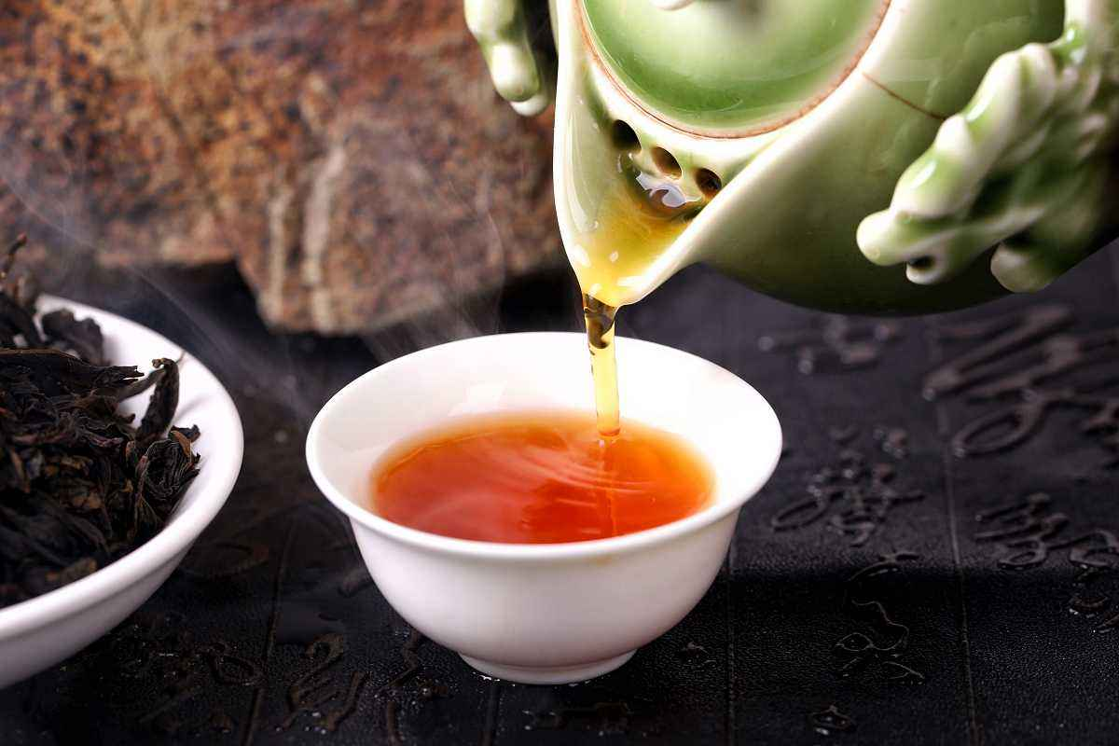
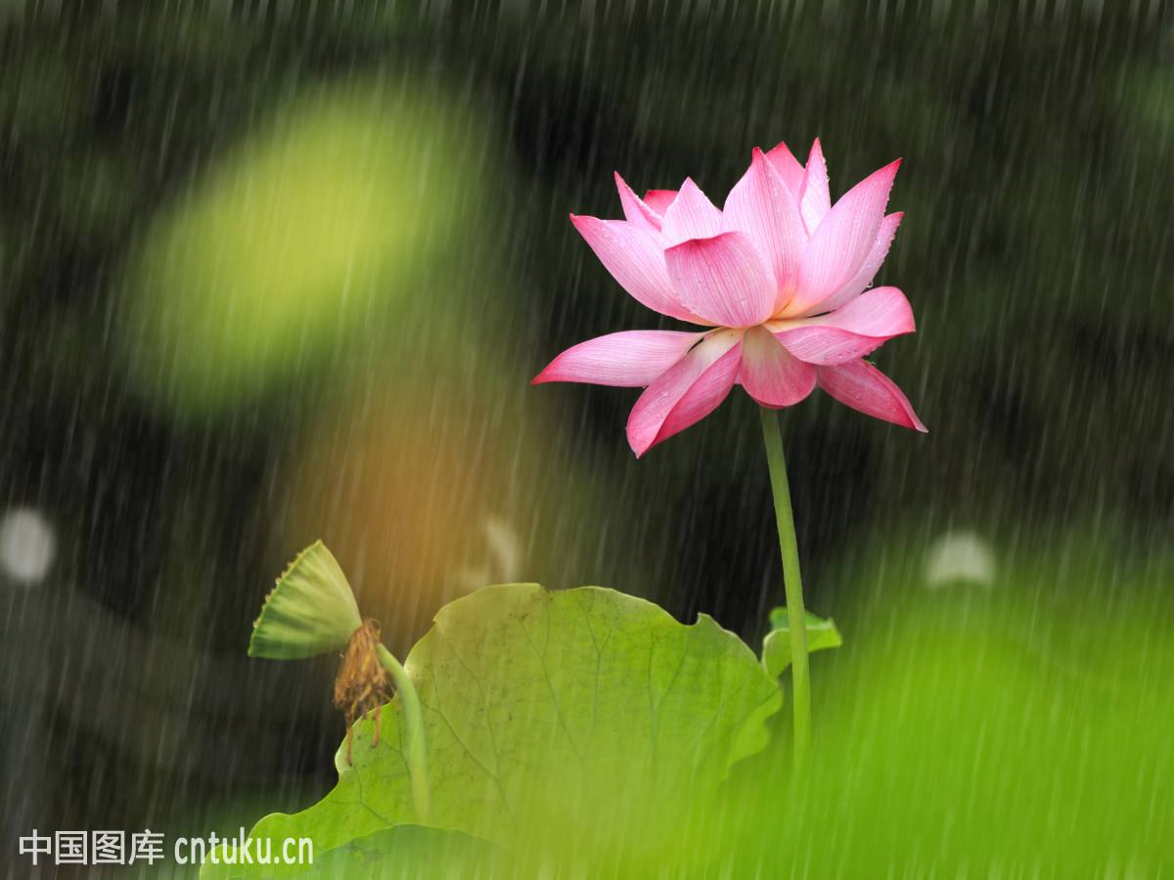
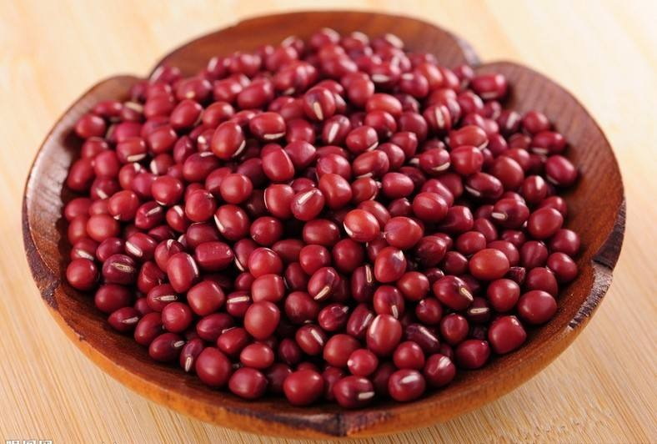
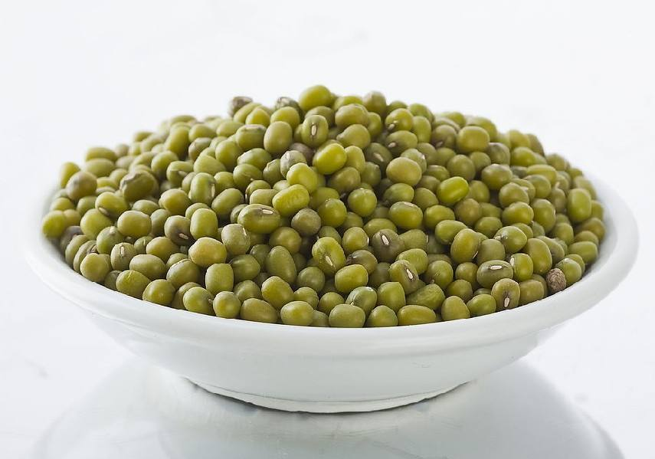
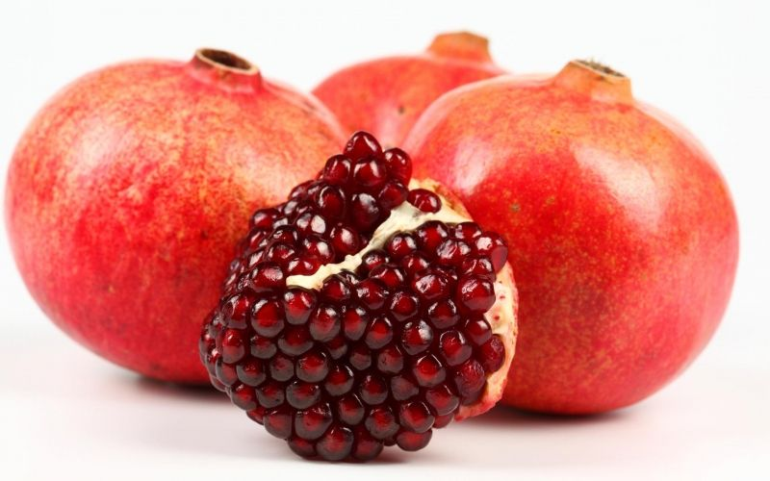
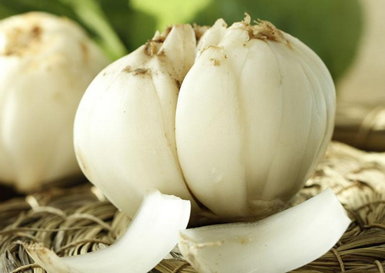
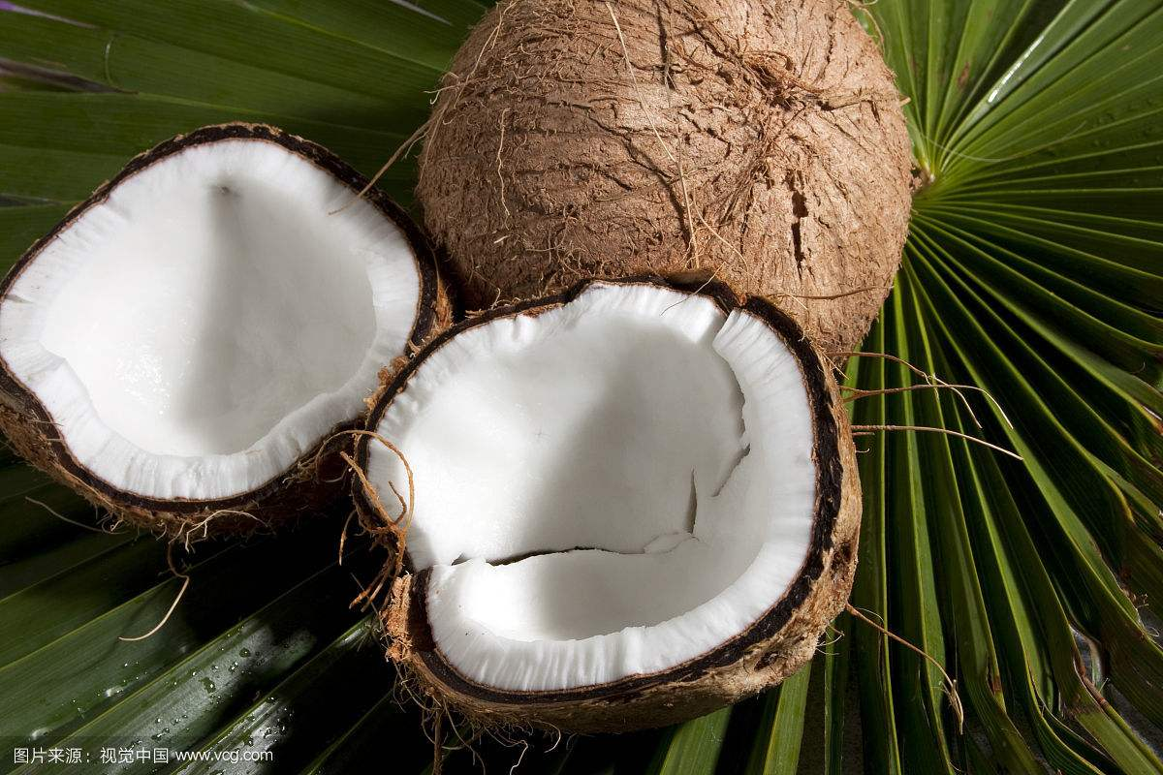
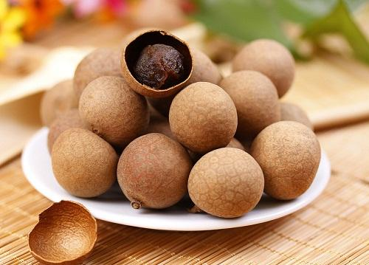
4.纳征Presenting wedding gifts
After the betrothal letter and betrothal gifts are accepted, the groom's family will later formally send wedding gifts to the bride's family. Usually, gifts may include tea, lotus seeds, longan, red beans, green beans, oranges, pomegranate, and other delicacies，depending on local customs and family wealth.
老师，老师

Slide 25
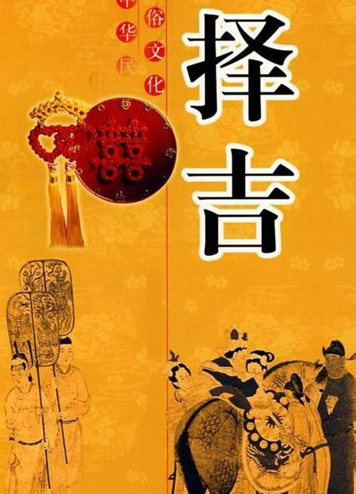
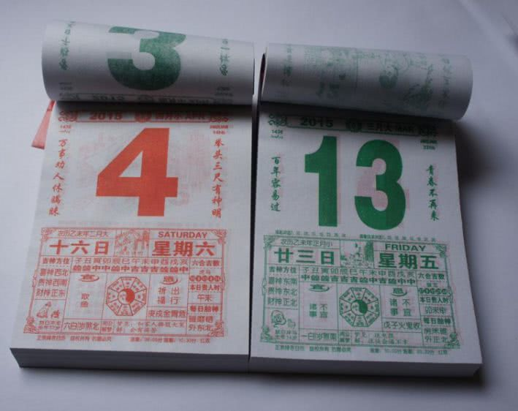
5.请期 Picking a wedding date
An astrologist or astrology book will be consulted to select an auspicious date to hold the wedding ceremony，that will decide by bride's family.

Slide 26
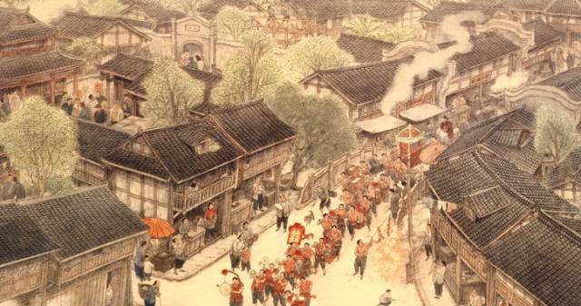
6.亲迎 Wedding ceremony
Picking up bride from her house and hold wedding ceremony.

Slide 27
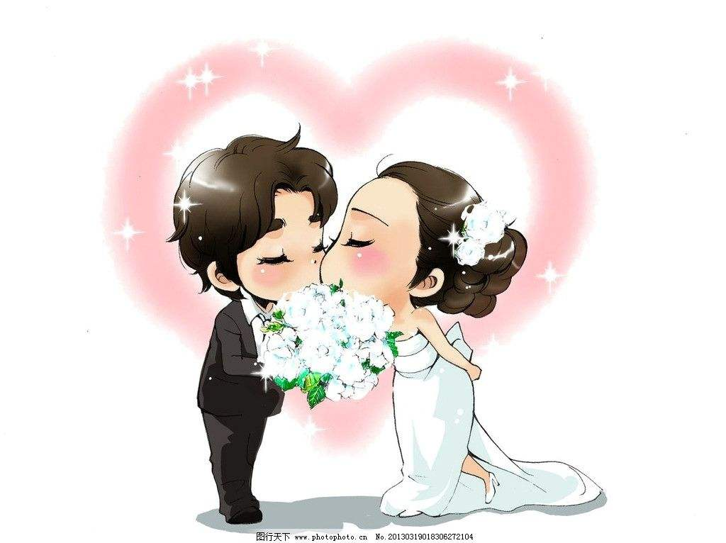
wedding

Slide 28
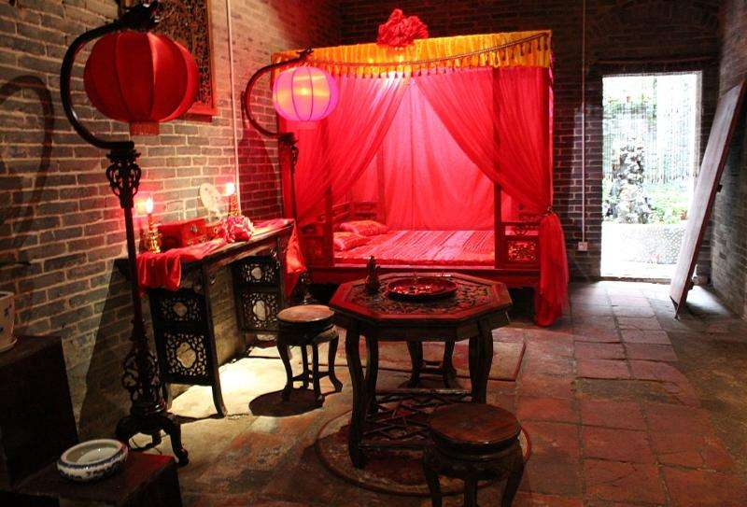
布置婚房（Installation of Room）
由儿女双全的人来布置婚房
（A man and woman with any children of both sexes were selected to install a newly purchased room．）
老师，老师

Slide 29
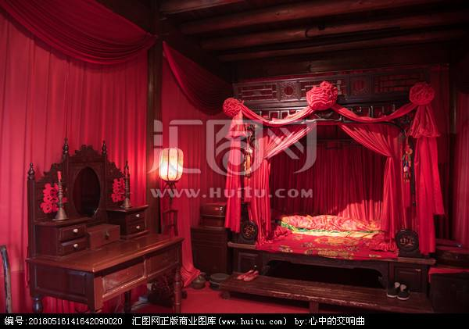
布置婚床（Installation of bed）
婚礼举行之前，会有家庭比较好的“喜婆”铺婚床，在床上撒有象征意义的水果。新婚夫妇婚礼之后进入新房之前，除了邀请来祝新人早生贵子的孩子外，任何人不得碰婚床。
Before the wedding，a "good luck woman" who has a nice family will arrange the bridal bed and scatter symbolic fruits on the bed. Nobody is allowed to touch the bed until the couple enters the bridal chamber after the wedding ceremony，except Children who are invited onto the bed to bless the couple with fertility.

Slide 30
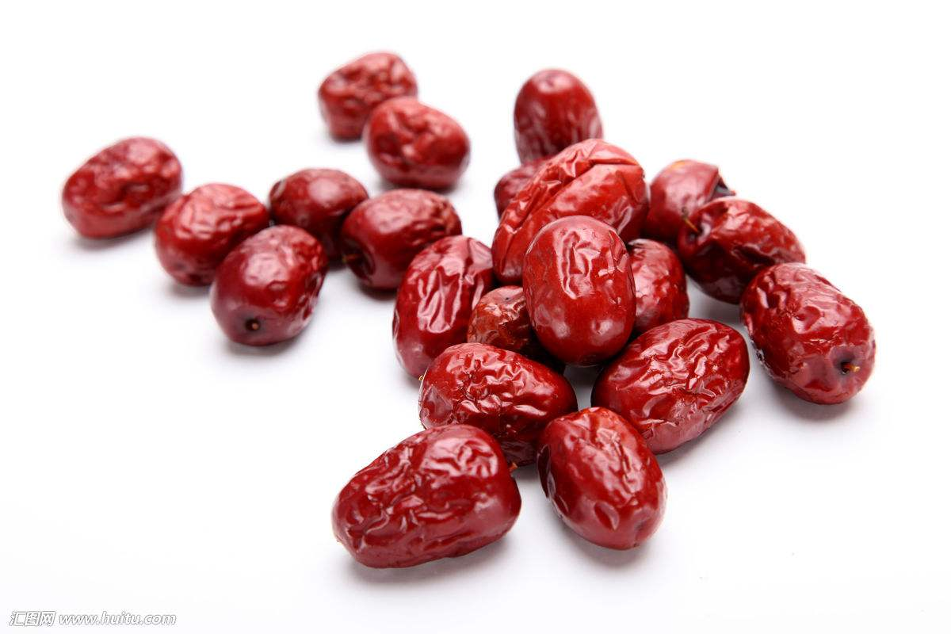
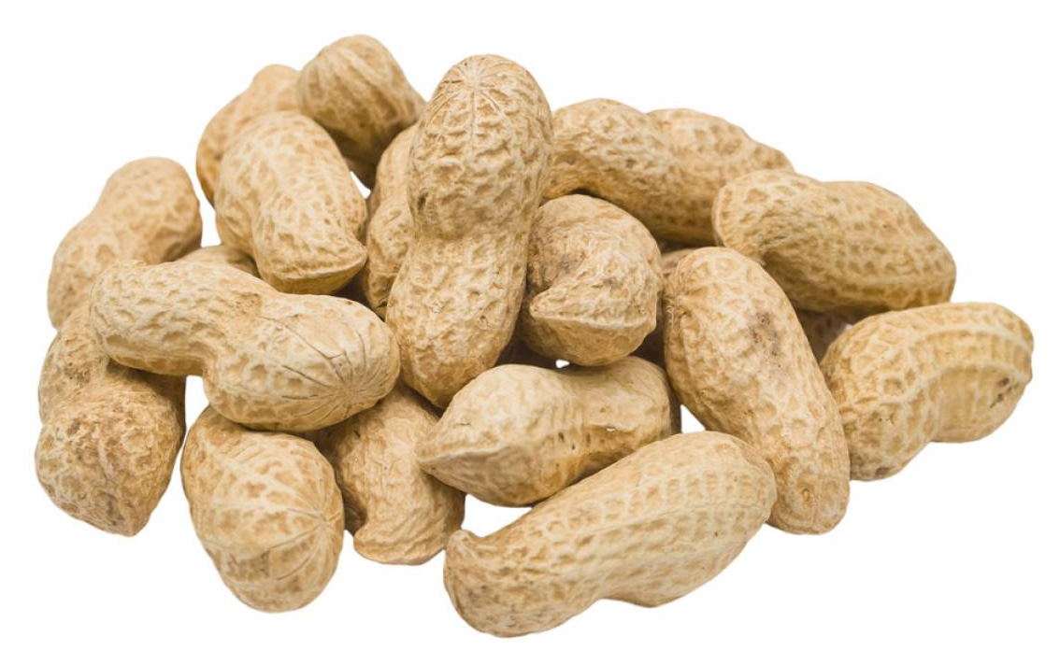
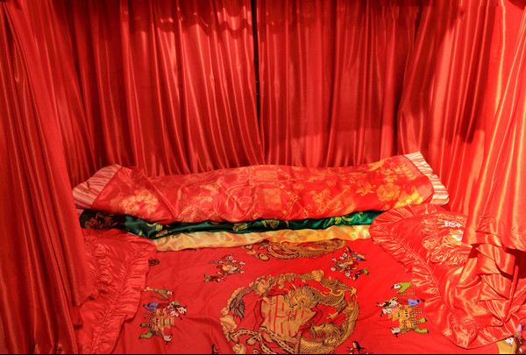
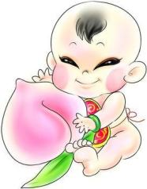
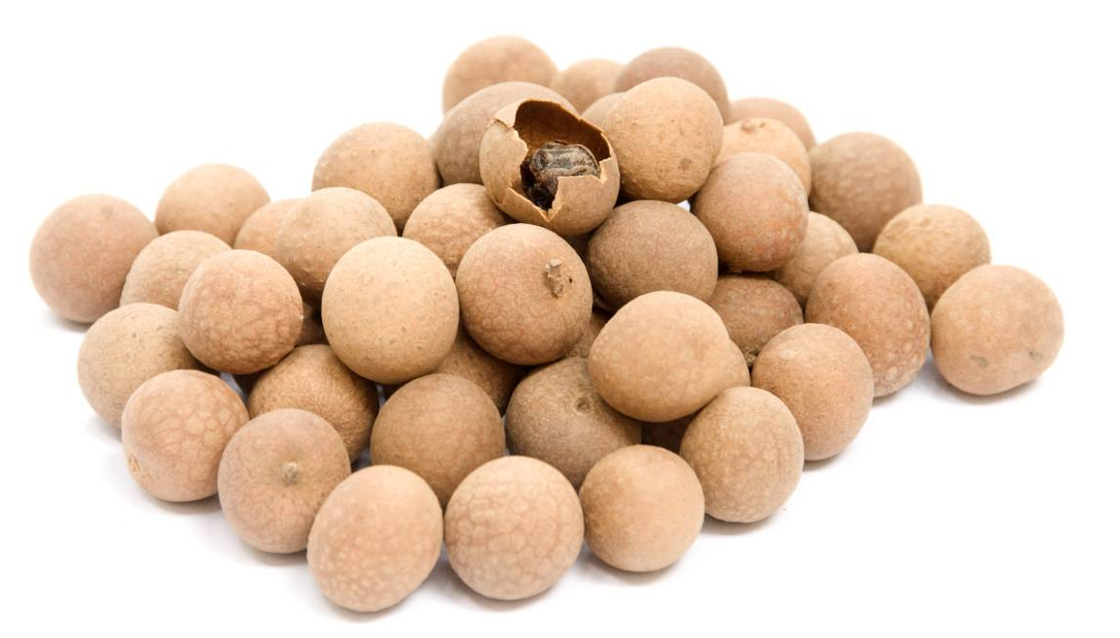
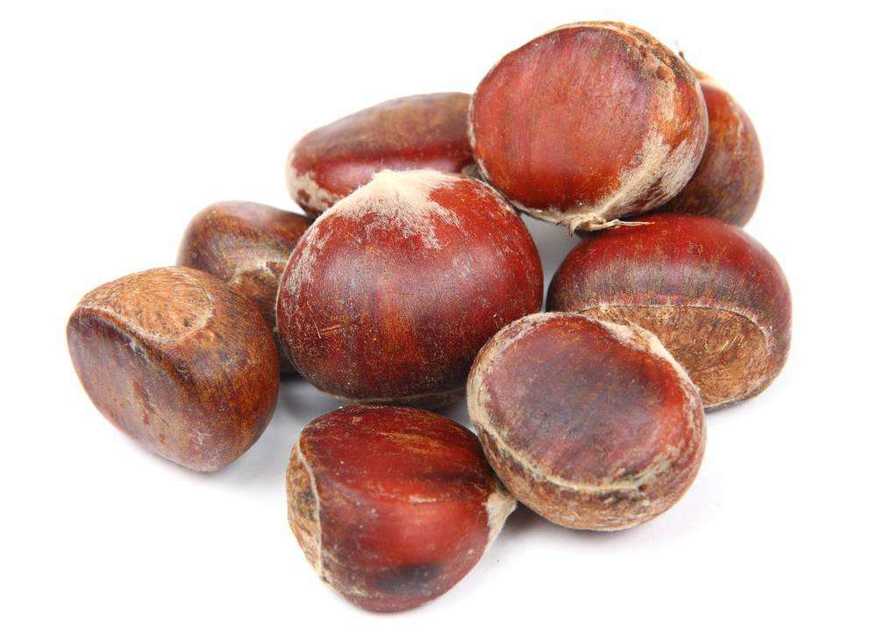
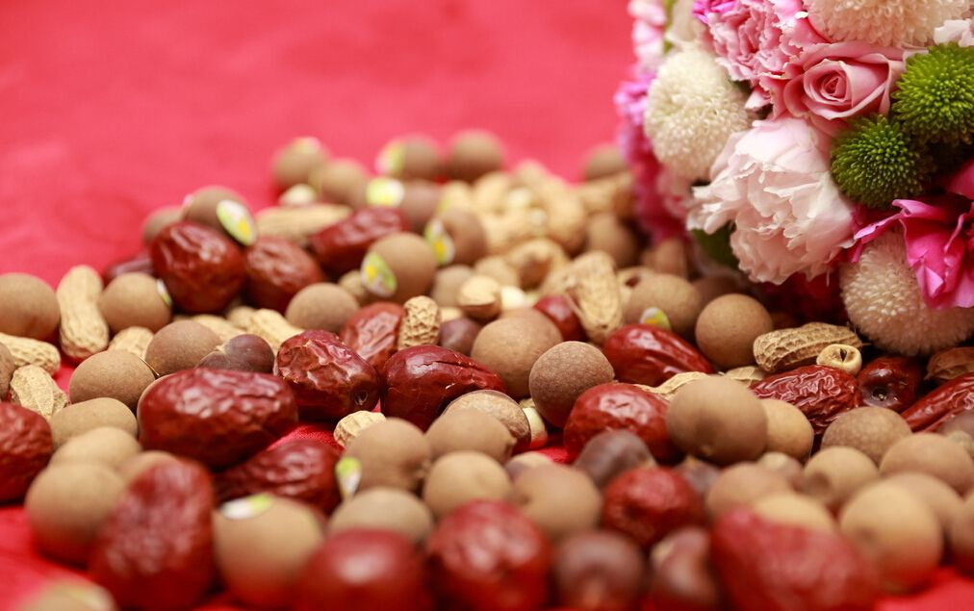
安床：早生贵子（Have a lovely baby early）
Chinese date
枣 —— 早 zǎo
peanut
花生 —— 生shēnɡ
老师，老师
chestnut
栗子——子 zǐ
longan
桂圆——贵 ɡuì

Slide 31
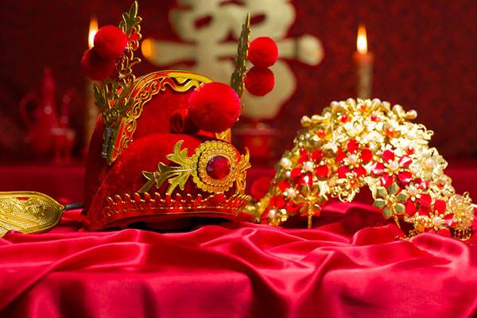
Wedding procedure

Slide 32
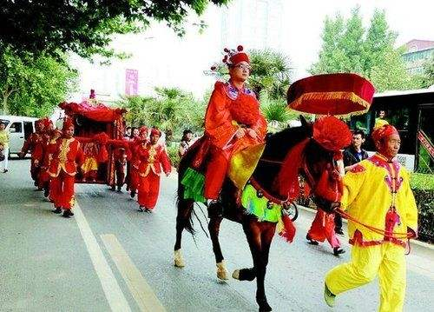
一、迎亲Escorting Bride to Groom's House
婚礼当天，迎亲队伍敲锣打鼓地陪同新郎去接新娘。
On the day of wedding，usually a crowd of people would escort the bridegroom to fetch the bride，while musicians would play joyful tunes during the entire trip.
老师，老师

Slide 33
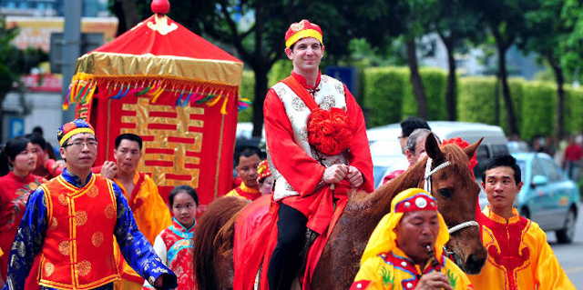
一、迎亲Escorting Bride to Groom's House
新郎胸前戴一朵大红花，骑在高头大马上。
The bridegroom rides on a big horse with a red Silk flower .

Slide 34
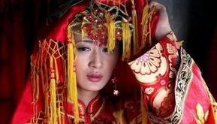
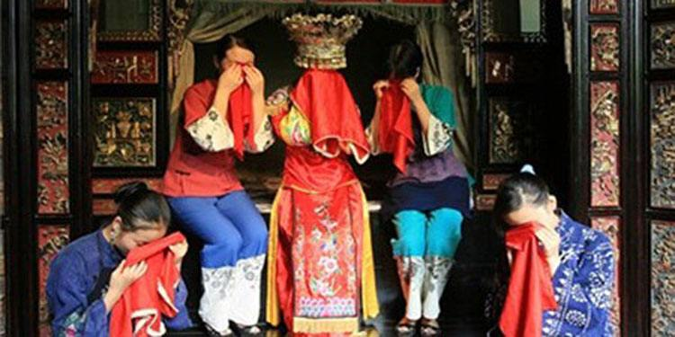
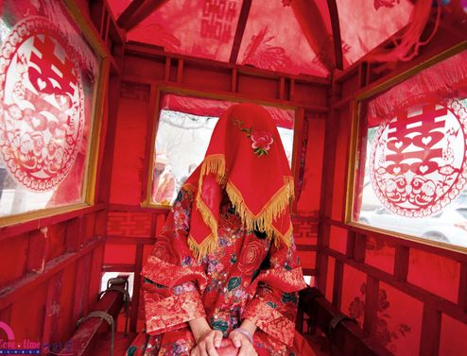
二、哭嫁 Wedding Lament
Before the bride departs to the bridegroom's home，the“good luck woman" will lead her to the sedan chair.The bride must cry to show her reluctance to leave her parents .

Slide 35

三、踢轿门 Kick the curtain of the sedan chair
当花轿停在男方家门前时，新郎至轿前，轻踢轿门一脚，踢去新娘的傲气。新娘还踢一脚。
When arriving at the gate, the bridegroom would kick the curtain of the sedan chair，to kicked off the bride's pride. Then, the bride should kick back.

Slide 36


四、跨火盆 Stride the fire pan
一对新人要从预先摆好的火盆上跨过，意思是烧去一切不吉利的东西，日后夫妻会越过越红火。
The couple have to stride from the fire pan set previously,meaning to burn all unlucky things and the future will be more and more prosperous.

Slide 37

五、三拜 Three kowtows
新人要共拉一条红绸沿红毯走到正堂，实施三次拜礼。
The new couple hold the two ends of a red ribbon respectively and meet on the red carpet on lobby. Based on the custom they would have three bows.

Slide 38

五、三拜 Three kowtows
First bow to worship the heaven and earth.
Yuelao:Heaven and earth, you can't live without them.

Slide 39

五、三拜 Three kowtows
second bow to worship their parents,to thank the parents for their lives and happiness.

Slide 40

五、三拜 Three kowtows
The third bow is that the new couple bow to each other that means they should love to old age.

Slide 41


六、敬茶 offer a cup of tea
老师，老师
在古代，茶有着特殊的意义，结婚以茶为证，当时意为女子要对丈夫服从和专一。
The marriage was witnessed by tea, which at that time meant a woman's obedience and devotion to her husband.

Slide 42

七、give red envelopes
老师，老师
After that, the superiors（长辈） will give them red packages with monetary gifts and wish them well.

Slide 43


八、送入洞房 Enter the bridal chamber
The bride and groom are sent into the bridal chamber.The bride Sit up in bed to Wait.

Slide 44

九、婚宴 wedding banquet
The groom’s family will then give a banquet for the friends and relatives to celebrate the wedding.

Slide 45



十、洞房花烛夜 Wedding night
The groom must stir up the red veil during the wedding night.
The bride and groom will drink “wedlock wine ” ,that means All In One,never to be separated .
On the wedding night, all friends and relatives will tease the the new couple in very well-meant ways.

Slide 46
the first visit of a bride to her parents

Slide 47

婚后回门 the first visit of a bride to her parents
回门即女儿和女婿回女家认门拜亲。回门的时间各地不一，回门主要是为感谢女方家长的养育之恩。
The newlyweds were to return to visit the bride's parents after the wedding at different periods .
老师，老师

Slide 48


Slide 49

变化（variation)
老师，老师
简单化：simplify
去封建化：alter old customs and habits
中西合璧：Combination of Chinese and western

Slide 50

Wedding procedure

Slide 51
传承浓郁的传统韵味
(Holding a traditional wedding is a fashion in modern times)
订婚
engagement
送聘礼备嫁妆
betrothal oresents and preparing the dowry
迎亲
escorting bride to Groom's house
婚礼
wedding
宴请亲朋好友
wedding banquet

Slide 52

Engagment
Will you marry me？
Yes！I do!
The man make a propose to the women and put on the engagment ring for her.
老师，老师

Slide 53




结婚照(wedding photos)
老师，老师

Slide 54


Escorting Bride to Groom's House
老师，老师
花车(flower car)

Slide 55


Escorting Bride to Groom's House
老师，老师
鞭炮(firecrackers )

Slide 56


Groom's House
老师，老师

Slide 57


Stop the bridegroom
老师，老师
Games、give red envelopes

Slide 58


Escorting Bride to Groom's House
老师，老师
The groom wears shoes for the bride.
The bridegroom carried the bride to the car.

Slide 59


wedding
老师，老师
All the above wedding styles also contribute to the culture of Chinese

Slide 60


仪式（ceremony）
老师，老师

Slide 61


交接仪式（handover ceremony）
老师，老师

Slide 62


仪式（ceremony）
老师，老师

Slide 63

Bow
老师，老师

Slide 64


酒（wine）
老师，老师

Slide 65



Propose a toast
Traditional customs
老师，老师
Light up a cigarette

Slide 66


老师，老师
When can I eat your candy or drink your wine?

Slide 67


Slide 68
你知道婚礼的仪式吗？
Do you know the wedding ceremony?
你知道中国婚礼有哪些传统吗？
Do you know any traditions about Chinese weddings?
请说一说你们国家婚礼的传统。
Please tell me about the wedding tradition in your country.
老师，老师

Slide 69
THANK
YOU

